Slide 1
XML Schemas

Slide 2
Namespaces

Slide 3
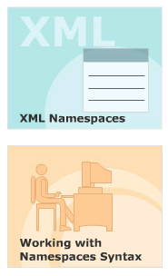
Module Introduction
Welcome to the module, Namespaces.
This module introduces XML Namespaces and the reasons for using Namespaces in XML documents.
This module aims at giving a clear understanding of Namespaces syntax.
In this module, you will learn about:
  XML Namespaces
  Working with Namespaces Syntax

Slide 4
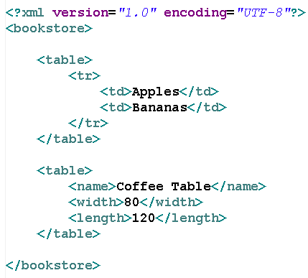
Need for a Namespace
In XML, element names are defined by the developer.
This often results in a conflict when trying to mix XML documents from different XML applications.
XML Namespaces Provide a method to avoid element name conflicts.

Slide 5
Define Namespaces
In XML, elements are distinguished by using namespaces.
  XML Namespaces provide a globally unique name for an element or attribute so that they do not conflict one another.
A namespace is a collection of names that can be used as element names or attribute names in XML document.
Namespaces allow the browser to:
  Combine documents from different sources, and help identify the source of elements or attributes.
A Namespace is identified by the URI.

Slide 6
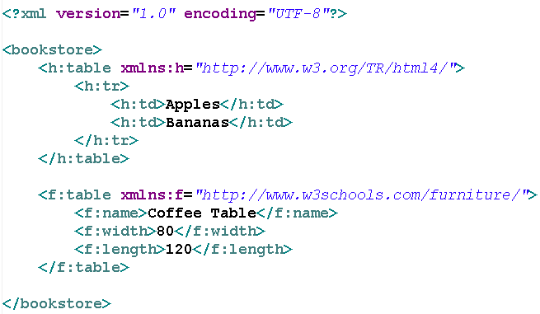
XML Namespaces Syntax- The “xmlns” Attribute
The namespace is defined by the “xmlns” attribute in the start tag of an element.
Syntax: xmlns:prefix="URI"
Prefix must not begin with “xml” or “xmlns”
The namespace URI is not used by the parser to look up information

Slide 7
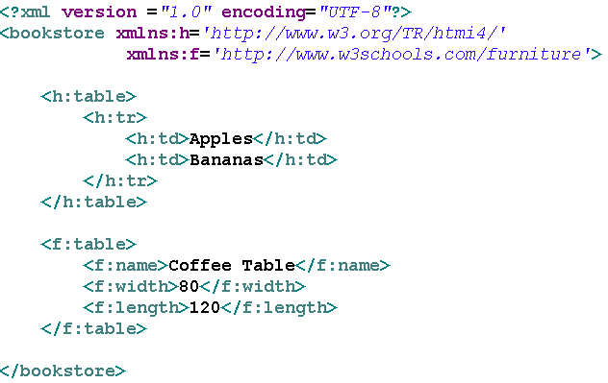
XML Namespaces Syntax- The “xmlns” Attribute
Namespaces can be declared:
  In the elements where they are used
  In the XML root element

Slide 8
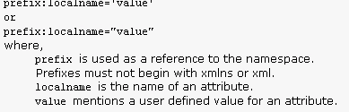
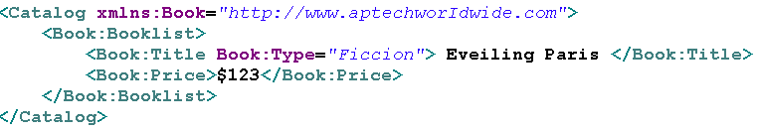
Placing attributes in a namespaces
Syntax
Example

Slide 9
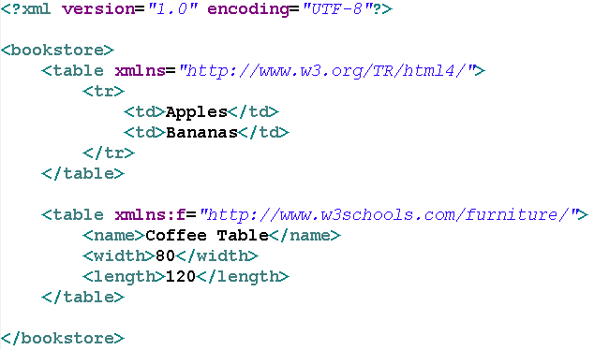
Default Namespaces
Defining a default namespace for an element saves us from using prefixes in all the child elements.
Syntax: xmlns="URI"

Slide 10
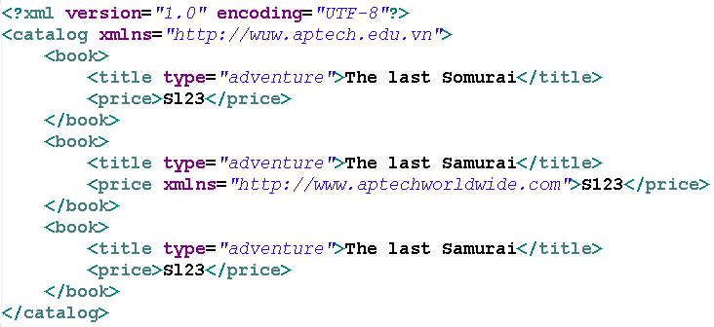
Override default namespaces
The default namespaces applies to the element on which it was defined and all descendant of that elements.
If one of the descendants has another default namespaces defines on it, this new namespace definition overrides the previous one and become the default for that element and all its descendents.

Slide 11
XML Schemas
“Schemas” is a general term--DTDs are a form of XML schemas
  According to the dictionary, a schema is “a structured framework or plan”
When we say “XML Schemas,” we usually mean the W3C XML Schema Language
  This is also known as “XML Schema Definition” language, or XSD
  I’ll use “XSD” frequently, because it’s short
DTDs, XML Schemas, and RELAX NG are all XML schema languages

Slide 12
Why XML Schemas?
DTDs provide a very weak specification language
  You can’t put any restrictions on text content
  You have very little control over mixed content (text plus elements)
  You have little control over ordering of elements
DTDs are written in a strange (non-XML) format
  You need separate parsers for DTDs and XML
The XML Schema Definition language solves these problems
  XSD gives you much more control over structure and content
  XSD is written in XML

Slide 13
Why not XML schemas?
DTDs have been around longer than XSD
  Therefore they are more widely used
  Also, more tools support them
XSD is very verbose, even by XML standards
More advanced XML Schema instructions can be non-intuitive and confusing
Nevertheless, XSD is not likely to go away quickly

Slide 14
Referring to a schema
To refer to a DTD in an XML document, the reference goes before the root element:
  <?xml version="1.0"?>
  <!DOCTYPE rootElement SYSTEM "url">
  <rootElement> ... </rootElement>
To refer to an XML Schema in an XML document, the reference goes in the root element:
  <?xml version="1.0"?>
  <rootElement
  xmlns:xsi="http://www.w3.org/2001/XMLSchema-instance"
  (The XML Schema Instance reference is required)
  xsi:noNamespaceSchemaLocation="url.xsd">
  (This is where your XML Schema definition can be found)
  ...
  </rootElement>

Slide 15
The XSD document
Since the XSD is written in XML, it can get confusing which we are talking about
Except for the additions to the root element of our XML data document, the rest of this lecture is about the XSD schema document
The file extension is .xsd
The root element is <schema>
The XSD starts like this:
  <?xml version="1.0"?>
  <xs:schema xmlns:xs="http://www.w3.rg/2001/XMLSchema">

Slide 16
<schema>
The <schema> element may have attributes:
  xmlns:xs="http://www.w3.org/2001/XMLSchema"
    This is necessary to specify where all our XSD tags are defined
  elementFormDefault="qualified"
    This means that all XML elements must be qualified (use a namespace)
    It is highly desirable to qualify all elements, or problems will arise when another schema is added

Slide 17
“Simple” and “complex” elements
A “simple” element is one that contains text and nothing else
  A simple element cannot have attributes
  A simple element cannot contain other elements
  A simple element cannot be empty
  However, the text can be of many different types, and may have various restrictions applied to it
If an element isn’t simple, it’s “complex”
  A complex element may have attributes
  A complex element may be empty, or it may contain text, other elements, or both text and other elements

Slide 18
Defining a simple element
A simple element is defined as
<xs:element name="name" type="type" />
where:
  name is the name of the element
  the most common values for type are
  xs:boolean xs:integer
  xs:date xs:string
  xs:decimal xs:time
Other attributes a simple element may have:
  default="default value" if no other value is specified
  fixed="value" no other value may be specified

Slide 19
Defining an attribute
Attributes themselves are always declared as simple types
An attribute is defined as
<xs:attribute name="name" type="type" />
where:
  name and type are the same as for xs:element
Other attributes a simple element may have:
  default="default value" if no other value is specified
  fixed="value" no other value may be specified
  use="optional" the attribute is not required (default)
  use="required" the attribute must be present

Slide 20
Attribute
XML
  <student id="A1">...</student>
Schema
  <xsd:element name="student" type="student_type" />
  <xsd:complexType name="student_type">
  <xsd:sequence>
  ...
  </xsd:sequence>
  <xsd:attribute name="id" type="xsd:ID"/>
  </xsd:complexType>
  type="xsd:ID"/> : unique value for attribute.
  Note: id must start with Letter.

Slide 21
XML Schema extension Element
The extension element extends an existing simpleType or complexType element.
<?xml version="1.0"?>
<xs:schema xmlns:xs="http://www.w3.org/2001/XMLSchema">
<xs:simpleType name="size">
<xs:restriction base="xs:string">
<xs:enumeration value="small" />
<xs:enumeration value="medium" />
<xs:enumeration value="large" />
</xs:restriction>
</xs:simpleType>
Continue…

Slide 22
XML Schema extension Element
The extension element extends an existing simpleType or complexType element.
<xs:complexType name="jeans">
<xs:simpleContent>
<xs:extension base="size">
<xs:attribute name="sex">
<xs:simpleType>
<xs:restriction base="xs:string">
<xs:enumeration value="male" />
<xs:enumeration value="female" />
</xs:restriction>
</xs:simpleType>
</xs:attribute>
</xs:extension>
</xs:simpleContent>
</xs:complexType>
</xs:schema>

Slide 23
Example Attribute
<xs:attribute name = "rollno" type = "xs:integer"/>
<xs:attribute name = "grade" type = "xs:string" default = "NA" />
<xs:attribute name = "class" type = "xs:string" fixed = "1" />
<xs:attribute name = "rollno" type = "xs:integer“
use = "required"/>
<xs:attribute name = "rollno" type = "xs:integer“
use = “optional"/>

Slide 24
Restrictions, or “facets”
The general form for putting a restriction on a text value is:
  <xs:element name="name"> (or xs:attribute)
  <xs:restriction base="type">
  ... the restrictions ...
  </xs:restriction>
  </xs:element>
For example:
  <xs:element name="age">
  <xs:restriction base="xs:integer">
  <xs:minInclusive value="0">
  <xs:maxInclusive value="140">
  </xs:restriction>
  </xs:element>

Slide 25
Restrictions on numbers
minInclusive -- number must be ≥ the given value
minExclusive -- number must be > the given value
maxInclusive -- number must be ≤ the given value
maxExclusive -- number must be < the given value
totalDigits -- number must have exactly value digits
fractionDigits -- number must have no more than value digits after the decimal point

Slide 26
Restrictions on strings
length -- the string must contain exactly value characters
minLength -- the string must contain at least value characters
maxLength -- the string must contain no more than value characters
pattern -- the value is a regular expression that the string must match
whiteSpace -- not really a “restriction”--tells what to do with whitespace
  value="preserve" Keep all whitespace
  value="replace" Change all whitespace characters to spaces
  value="collapse" Remove leading and trailing whitespace, and
  replace all sequences of whitespace with a single space

Slide 27
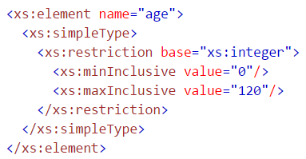
XSD Restrictions/Facets
The following example defines an element called "age" with a restriction. The value of age cannot be lower than 0 or greater than 120:

Slide 28
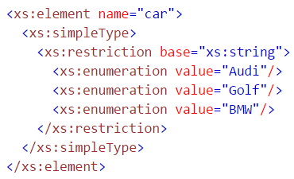
Restrictions on a Set of Values
The example below defines an element called "car" with a restriction. The only acceptable values are: Audi, Golf, BMW:

Slide 29
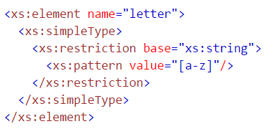
Restrictions on a Series of Values
The example below defines an element called "letter" with a restriction. The only acceptable value is ONE of the LOWERCASE letters from a to z:

Slide 30
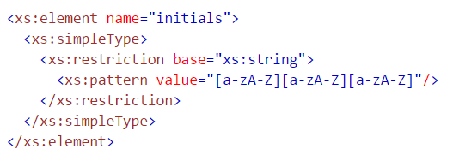
Restrictions on a Series of Values
The next example also defines an element called "initials" with a restriction. The only acceptable value is THREE of the LOWERCASE OR UPPERCASE letters from a to z:

Slide 31
Restrictions on a Series of Values
The only acceptable value is ONE of the following letters: x, y, OR z:
<xs:element name="choice">
<xs:simpleType>
<xs:restriction base="xs:string">
<xs:pattern value="[xyz]"/>
</xs:restriction>
</xs:simpleType>
</xs:element>

Slide 32
Restrictions on a Series of Values
The only acceptable value is FIVE digits in a sequence, and each digit must be in a range from 0 to 9:
<xs:element name="prodid">
<xs:simpleType>
<xs:restriction base="xs:integer">
<xs:pattern value="[0-9][0-9][0-9][0-9][0-9]"/>
</xs:restriction>
</xs:simpleType>
</xs:element>
Or value = “\d{5}”

Slide 33
Restrictions on a Series of Values
The acceptable value is one or more pairs of letters, each pair consisting of a lower case letter followed by an upper case letter. For example, "sToP" will be validated by this pattern, but not "Stop" or "STOP" or "stop":
<xs:element name="letter">
<xs:simpleType>
<xs:restriction base="xs:string">
<xs:pattern value="([a-z][A-Z])+"/>
</xs:restriction>
</xs:simpleType>
</xs:element>

Slide 34
Restrictions on a Series of Values
The only acceptable value is male OR female:
<xs:element name="gender">
<xs:simpleType>
<xs:restriction base="xs:string">
<xs:pattern value="male|female"/>
</xs:restriction>
</xs:simpleType>
</xs:element>

Slide 35
Restrictions on a Series of Values
There must be exactly eight characters in a row and those characters must be lowercase or uppercase letters from a to z, or a number from 0 to 9:
<xs:element name="password">
<xs:simpleType>
<xs:restriction base="xs:string">
<xs:pattern value="[a-zA-Z0-9]{8}"/>
</xs:restriction>
</xs:simpleType>
</xs:element>

Slide 36
Length of string
<xs:element name="password1">
<xs:simpleType>
<xs:restriction base="xs:string">
<xs:length value="8"/>
</xs:restriction>
</xs:simpleType>
</xs:element>
<xs:element name="password2">
<xs:simpleType>
<xs:restriction base="xs:string">
<xs:minLength value="5"/>
<xs:maxLength value="8"/>
</xs:restriction>
</xs:simpleType>
</xs:element>

Slide 37
Enumeration
An enumeration restricts the value to be one of a fixed set of values
Example:
  <xs:element name="season">
  <xs:simpleType>
  <xs:restriction base="xs:string">
  <xs:enumeration value="Spring"/>
  <xs:enumeration value="Summer"/>
  <xs:enumeration value="Autumn"/>
  <xs:enumeration value="Fall"/>
  <xs:enumeration value="Winter"/>
  </xs:restriction>
  </xs:simpleType>
  </xs:element>

Slide 38
Complex elements
A complex element is defined as
<xs:element name="name">
<xs:complexType>
... information about the complex type...
</xs:complexType>
</xs:element>
Example:
<xs:element name="person">
<xs:complexType>
<xs:sequence>
<xs:element name="firstName" type="xs:string" />
<xs:element name="lastName" type="xs:string" />
</xs:sequence>
</xs:complexType>
</xs:element>
<xs:sequence> says that elements must occur in this order
Remember that attributes are always simple types

Slide 39
Global and local definitions
Elements declared at the “top level” of a <schema> are available for use throughout the schema
Elements declared within a xs:complexType are local to that type
Thus, in
<xs:element name="person">
<xs:complexType>
<xs:sequence>
<xs:element name="firstName" type="xs:string" />
<xs:element name="lastName" type="xs:string" />
</xs:sequence>
</xs:complexType>
</xs:element>
the elements firstName and lastName are only locally declared
The order of declarations at the “top level” of a <schema> do not specify the order in the XML data document

Slide 40
Declaration and use
So far we’ve been talking about how to declare types, not how to use them
To use a type we have declared, use it as the value of type="..."
  Examples:
    <xs:element name="student" type="person"/>
    <xs:element name="professor" type="person"/>
  Scope is important: you cannot use a type if is local to some other type

Slide 41
Defining new Datatypes
If the the built-in datatypes are not enough, you can build your own datatypes.
This does not necessarily work:
  <xsd:element name="grade" type="xsd:integer" />
There are two ways of specifying your own datatype
  Named Data Type
  Anonymous Data Type

Slide 42
1) Named Data Type
<?xml version="1.0"?>
<xsd:schema xmlns:xsd="http://www.w3.org/2001/XMLSchema">
<xsd:element name="grade" type="grade_type" />
<xsd:simpleType name="grade_type">
<xsd:restriction base="xsd:positiveInteger">
<xsd:minInclusive value="4"/>
<xsd:maxInclusive value="10"/>
</xsd:restriction>
</xsd:simpleType>
</xsd:schema>

Slide 43
2) Anonymous Data Type
<?xml version="1.0"?>
<xsd:schema xmlns:xsd="http://www.w3.org/2001/XMLSchema">
<xsd:element name="grade">
<xsd:simpleType>
<xsd:restriction base="xsd:positiveInteger">
<xsd:minInclusive value="4"/>
<xsd:maxInclusive value="10"/>
</xsd:restriction>
</xsd:simpleType>
</xsd:element>
</xsd:schema>

Slide 44
Benefits of Named Data Type
If you want re-use your datatype:
<?xml version="1.0"?>
<xsd:schema xmlns:xsd="http://www.w3.org/2001/XMLSchema">
<xsd:element name="grade" type="grade_type" />
<xsd:element name="teachers_IQ" type="grade_type" />
<xsd:simpleType name="grade_type">
<xsd:restriction base="xsd:positiveInteger">
<xsd:minInclusive value="4"/>
<xsd:maxInclusive value="10"/>
</xsd:restriction>
</xsd:simpleType>
</xsd:schema>

Slide 45
Order of the elements
Sequence: Elements appear in same order than in Schema
All: Elements can appear in any order
Choice: One element can appear from the choice-list
<xsd:element name="person">
<xsd:complexType>
<xsd:choice>
<xsd:element name="employee" type="employee"/>
<xsd:element name="member" type="member"/>
</xsd:choice>
</xsd:complexType>
</xsd:element>

Slide 46
xs:sequence
We’ve already seen an example of a complex type whose elements must occur in a specific order:
<xs:element name="person">
<xs:complexType>
<xs:sequence>
<xs:element name="firstName" type="xs:string" />
<xs:element name="lastName" type="xs:string" />
</xs:sequence>
</xs:complexType>
</xs:element>

Slide 47
xs:all
xs:all allows elements to appear in any order
<xs:element name="person">
<xs:complexType>
<xs:all>
<xs:element name="firstName" type="xs:string" />
<xs:element name="lastName" type="xs:string" />
</xs:all>
</xs:complexType>
</xs:element>
Despite the name, the members of an xs:all group can occur once or not at all
You can use minOccurs="0" to specify that an element is optional (default value is 1)
  In this context, maxOccurs is always 1

Slide 48
Referencing
Once you have defined an element or attribute (with name="..."), you can refer to it with ref="..."
Example:
  <xs:element name="person">
  <xs:complexType>
  <xs:all>
  <xs:element name="firstName" type="xs:string" />
  <xs:element name="lastName" type="xs:string" />
  </xs:all>
  </xs:complexType>
  </xs:element>
  <xs:element name="student" ref="person">
  Or just: <xs:element ref="person">

Slide 49
Text element with attributes
If a text element has attributes, it is no longer a simple type
  <xs:element name="population">
  <xs:complexType>
  <xs:simpleContent>
  <xs:extension base="xs:integer">
  <xs:attribute name="year”
  type="xs:integer">
  </xs:extension>
  </xs:simpleContent>
  </xs:complexType>
  </xs:element>

Slide 50
Empty elements
Empty elements are (ridiculously) complex
<xs:complexType name="counter">
<xs:complexContent>
<xs:extension base="xs:anyType"/>
<xs:attribute name="count" type="xs:integer"/>
</xs:complexContent>
</xs:complexType>

Slide 51
Mixed elements
Mixed elements may contain both text and elements
We add mixed="true" to the xs:complexType element
The text itself is not mentioned in the element, and may go anywhere (it is basically ignored)
<xs:complexType name="paragraph" mixed="true">
<xs:sequence>
<xs:element name="someName”
type="xs:anyType"/>
</xs:sequence>
</xs:complexType>

Slide 52
Extensions
You can base a complex type on another complex type
<xs:complexType name="newType">
<xs:complexContent>
<xs:extension base="otherType">
...new stuff...
</xs:extension>
</xs:complexContent>
</xs:complexType>

Slide 53
Predefined string types
Recall that a simple element is defined as:
<xs:element name="name" type="type" />
Here are a few of the possible string types:
  xs:string -- a string
  xs:normalizedString -- a string that doesn’t contain tabs, newlines, or carriage returns
  xs:token -- a string that doesn’t contain any whitespace other than single spaces
Allowable restrictions on strings:
  enumeration, length, maxLength, minLength, pattern, whiteSpace

Slide 54
Predefined date and time types
xs:date -- A date in the format CCYY-MM-DD, for example, 2002-11-05
xs:time -- A date in the format hh:mm:ss (hours, minutes, seconds)
xs:dateTime -- Format is CCYY-MM-DDThh:mm:ss
  The T is part of the syntax
Allowable restrictions on dates and times:
  enumeration, minInclusive, minExclusive, maxInclusive, maxExclusive, pattern, whiteSpace

Slide 55
Predefined numeric types
Here are some of the predefined numeric types:
xs:decimal xs:positiveInteger
xs:byte xs:negativeInteger
xs:short xs:nonPositiveInteger
xs:int xs:nonNegativeInteger
xs:long
Allowable restrictions on numeric types:
  enumeration, minInclusive, minExclusive, maxInclusive, maxExclusive, fractionDigits, totalDigits, pattern, whiteSpace

Slide 56
The End

